Slide 1
AP Statistics
Section 8.2
Geometric Distributions

Slide 2
Game of STOCKS
6 rounds, collect points as two dice are rolled
Round is over when a pair is rolled
You must sit before a pair is rolled, otherwise all your points that round will be removed
When a double is rolled, all your points from all previous round will be removed if you are still standing
The first 3 rolls of each round will be pair free
Team with the most points at the end of 6 rounds win
Dice Rolling APPLET

Slide 4
Activity: Rolling a Dice
Suppose you roll a die, how many rolls would you need to get a 3?
Record the number of rolls required to get the first 3.

Slide 5
Geometric Distribution:
Geometric distribution is a probability distribution that describes the number of trials required for the “first” success to occur
Conditions:
1. Binary Outcomes – there are only two outcomes ‘p’: success, ‘q’: failure
  p + q = 1 The sum of the two events add to 100%
2. Independent Trials
  Outcome of each trial should not affect each other
3. Constant Probability of Success
  “p” must be constant
4. The number of trials is NOT fixed…. can be a very large number

Slide 6
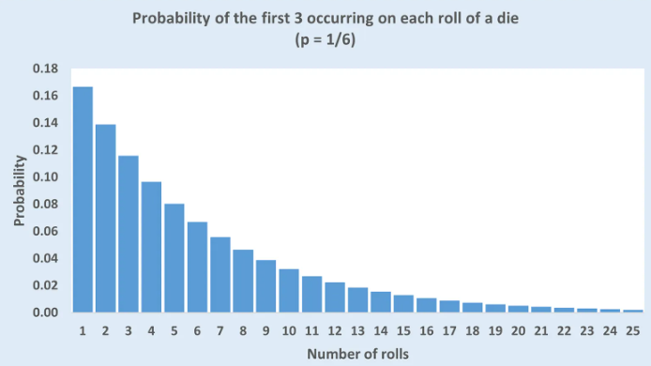
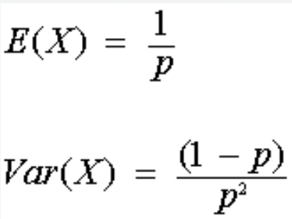
Image of a Geometric Distribution:
This distribution shows the probability of rolling a die and getting the “FIRST” 3 at the following number of rolls

Slide 7
GeometricPDF(p,x) and GeometricCDF(p,x)
Suppose the probability of rolling a “3” is 1/6 and the probability of “NOT” rolling a “3” is 5/6
What is the probability of rolling a first “3” in your first roll?
The probability of getting your first “3” in the first roll would be 16.7%
What is the probability of rolling a first“3” in your second roll?
If you get your first 3 in the 2nd roll, that means that first roll must be a “failure”.
What is the probability of rolling a first “3” in your fourth roll?
First two rolls are failures. 3rd roll is your success

Slide 8
Q: Again, suppose you are rolling a die, what is the probability that it will take 3 or less rolls to get your first “3”?
Q: What is the probability that it will take 5 or less rolls to get your first “3”
Q: What is the probability that it will take atleast 6 rolls to get your first “3”?
The probability of taking 3 or less rolls to get your first “3” is equal to 1 minus all scenarios with 3 failures….
Atleast 6 rolls means that you will need 6 or more rolls. This means that the first 5 rolls MUST be all “FAILURES”

Slide 9
Geometric Distributions:
Random variable X – number of trials required to obtain the “FIRST SUCCESS”
“X” is a geometric random variable when (4 conditions):
  There are only two outcomes: Success or failure
  The variable of interest is the number of trials required to obtain the first success
  Each observation is independent
  The probability of success for each observation is the same
Since “n” is not fixed there could be an infinite number of “X” values
The probability histogram for a geometric is always skewed to the right

Slide 10
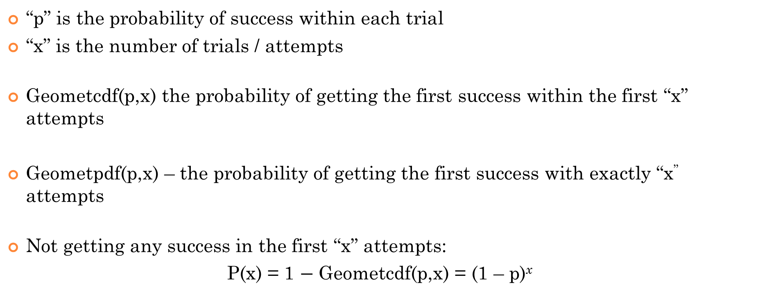
Geometric PDF vs CDF:
“p” is the probability of success within each trial
“x” is the number of trials / attempts
Geometcdf(p,x) the probability of getting the first success within the first “x” attempts
Geometpdf(p,x) – the probability of getting the first success with exactly “x” attempts
Not getting any success in the first “x” attempts:
P(x) = 1 $−$ Geometcdf(p,x) = (1 – p)^{x}

Slide 11
Ex: Indicate if the following can be modelled by a geometric distribution. Explain why or why not:
i) You keep rolling a single die (dice) until you get the same number 3 times in a row
ii) A student will keep asking people in his grade until he finds a prom date
iii) An insurance agent will keep phoning his clients until she finds her first client
Iv) A man will keep driving his car until the first day that it breaks down

Slide 12
i) You keep rolling a single die (dice) until you get the same number 3 times in a row
A single roll is one single trial. So the chance of success (getting 3 consecutive rolls) in the first roll is zero.
In the second roll (2nd trial), the chance of success is also zero.
In the 3rd roll (3rd trial), the chance of success depends on the previous two rolls. From what we see here, the chance of success between each trial is different. Therefore, this is NOT a geometric distribution.
ii) A student will keep asking people in his grade until he finds a prom date
The main problem of this question is how we view & understand probability in this scenario
Choice 1: The probability is defined as the probability an individual would say yes when asked to the prom. The probability of success in each trial would be difference.
Choice 2: There is a percentage of people in the school population who would say when asked. The probability of success is defined as the chance that the student will select one of these individuals in the population that will say yes.
We should use choice 2: So, therefore the ‘p’ of success in each trial would stay consistent.

Slide 13
iii) An insurance agent will keep phoning his clients until she finds her first client
In this scenario, imagine that a percentage of people in the population would say yes to being a client to the insurance agent. When the agent makes her calls, we are looking at the probability that the agent will reach one of the people in the population that would say yes.
Therefore, the probability of success of each trial would be similar.
NOTE: The probability SHOULD NOT change if REPEATS are allowed…..[Samuel….]
Iv) A man will keep driving his car until the first day that it breaks down
This one is NOT geometric b/c the probability of the car breaking down increases as it is driven.

Slide 14
Ex:A large company is hiring and will continue to interview candidates until someone suitable is interviewed. Suppose the probability that any candidate is suitable is 1/9 and every candidate is independent. Find the probability for the following
a) What is the probability that a suitable candidate can be found within the first 8 interviews?
There is 61% that a suitable candidate can be found within 8 interviews
Geometcdf(1/9,8) = 0.6102556596
b) What is the probability that a suitable candidate will not be found in the first 12 interviews?
1 - Geometcdf(1/9,12) = 0.24331547
OR
P( 12 failures) = (8/9)^12
There is 24.3% that a suitable candidate will not be found within 12 interviews
c) Given that you will not find a suitable candidate in the first 4 interviews, what is the probability that you will find a suitable candidate within the first 10 interviews?
First four are fails, then hoping that within next 6 a success is found
Geometcdf(1/9,6) = 0.5067298
NOTE: We are given that the first 4 are failures. Use this as the probability of our denominator:
d) Given that a suitable candidate was found in the first 10 interviews, what is the probability the candidate was found in the 5th interview?

Slide 15
Mean & Standard Deviation
If “p” is the probability of success from a single trial, the expected value (mean) and standard deviation of a geometric random variable is:
The probability that the first success will occur in “n” trials is given by the formula:
The probability
of (n –1) failures
The probability of
your first success
The probability that the first success will require more than “n” trials is given by the formula:

Slide 16
Proof for the mean of a Geometric Distribution:
Multiply both sides by (1-p)
Subtract the two equations!!!
Divide both sides by “p”
Infinite Geometric Series….

Slide 17
Ex: When rolling a die, let the random variable “X” be the number of rolls required to get your first “6”.
a) What is the expected value of “X?
b) What is the standard deviation of “X”
c) What is the probability that the first “6” will appear on the 5th roll?
d) What is the probability that the first “6” will require more than 10 rolls?
e) What is the probability that the first “6” will appear within the first 5 rolls?
We would expect to get
the first “6” in 6 rolls

Slide 18
d) What is the probability that the first
“6” will require more than 10 rolls?
e) What is the probability that the first
“6” will appear within the first 5 rolls?
There’s a 16.15% chance that the first “6” will require more than 10 rolls
Use the complement
There’s almost a 60% probability that the first “6”
will appear within the first 5 rolls

Slide 19
Ex: A game consist of rolling a die until a “3’ is observed. Let X be the number of rolls required to get the first 3.
a) Verify that X has a geometric distribution (Four conditions of G.D.)
b) Construct the probability distribution table to include atleast 10 entries for the probability of “X”. Record the probabilities to four decimal places.
c) Construct a graph of the PDF of “X” and plot its histogram
d) Construct a graph of the CDF of “X” and plot its histogram
a) There are 2 only outcomes: success – getting a 3,
failure – not getting a 3
Each observation is independent – rolling a die
Probability of getting a 3 in each roll is the same
The variable of interest is the number of trials required to
obtain the first success

Slide 20
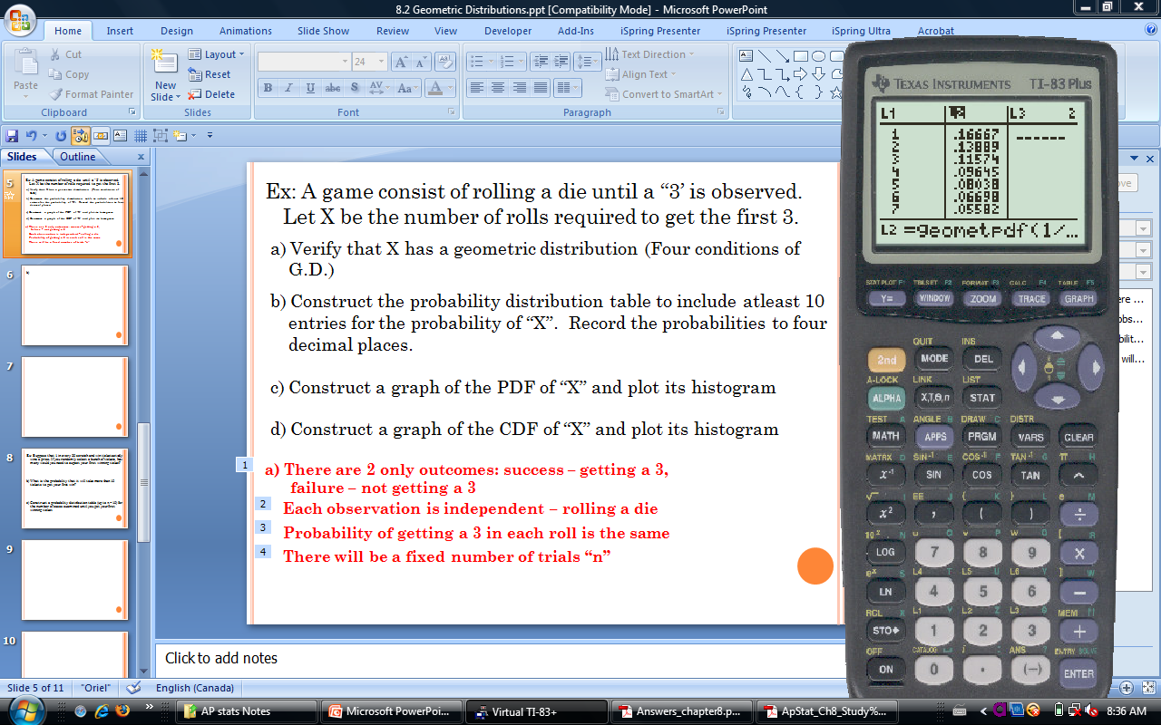
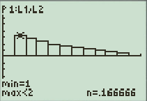
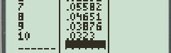
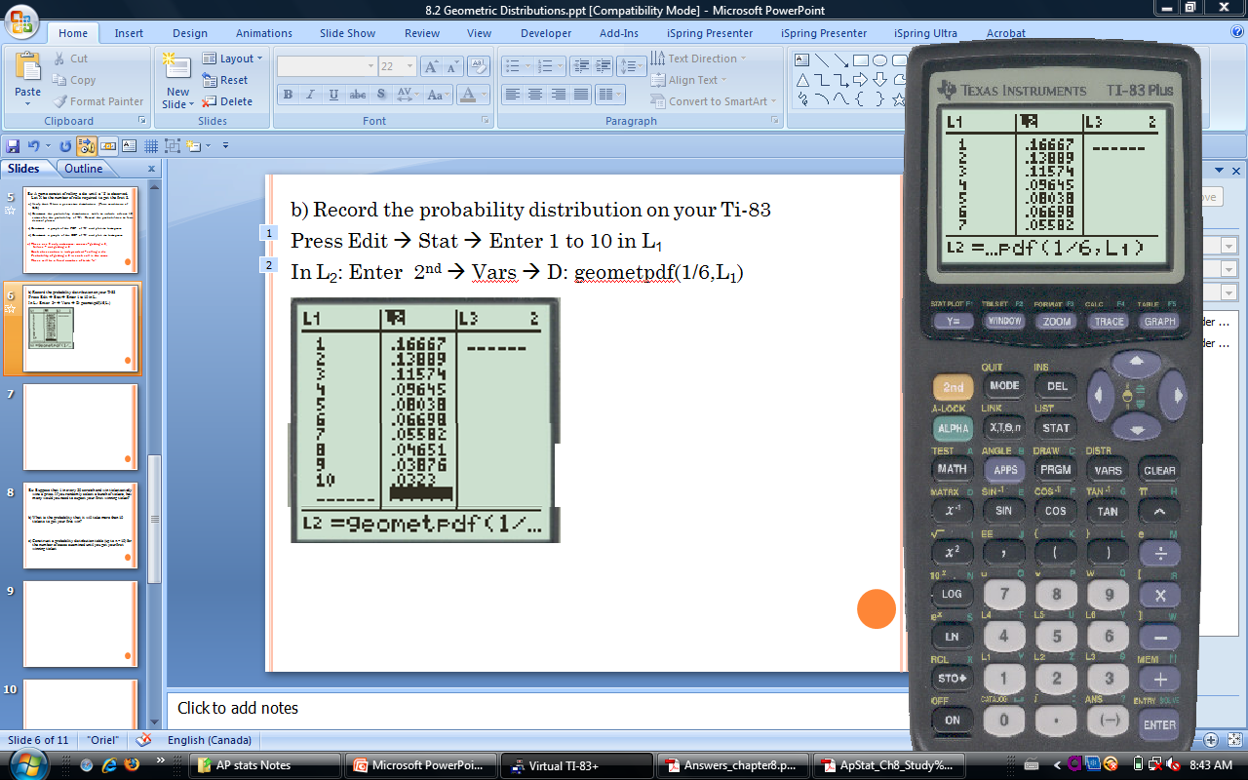
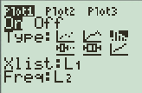
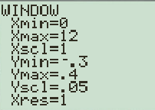
B & C) Record the probability distribution (PDF) on your Ti-83
Press Edit → Stat → Enter 1 to 10 in L₁
In L₂: Enter 2nd → Vars → D: geometpdf(1/6,L₁)
Histogram of the
PDF of “X”

Slide 21
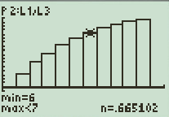
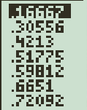
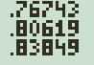
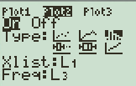
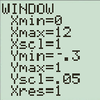
c) & d) Record the cumulative probability distribution (CDF) on your Ti-83
In L₂: Enter 2nd → Vars → E: geometcdf(1/6,L₁)
Histogram of the CDF of “X”

Slide 22
Ex: Suppose that 1 in every 50 scratch and win ticket actually wins a prize. If you randomly select a bunch of tickets, how many would you need to expect your first winning ticket?
b) What is the probability that it will take more than 10 tickets to get your first win?
c) Construct a cumulative probability distribution (CDF) table (up to n = 20) for the number of cases examined until you get your first winning ticket
An expected value of 20 indicates
that we would expect 20 tickets
to get our first winning ticket

Slide 23
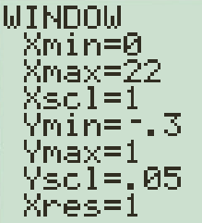
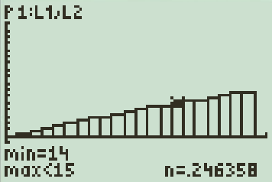
c) Probability Distribution Table:
Press: STAT → Edit → Enter 1 to 10 in L1
GO to L2 and Enter: 2nd → VARS → E:geometcdf (0.02,L1)

Slide 24
Ex: Government data reveal that approximately 65% of all divorce cases cite incompatibility as the underlying cause. Let “X” be the number of divorce cases that cite incompatibility.
A) You randomly select divorce cases to study. How many cases would you expect to see until you see one that cites incompatibility as the cause?
B) What is the probability that it takes more than 4 cases to find one that cites incompatibility?
C) Construct a probability distribution table (up to n = 5) for the number of cases examined until you find one that cites incompatibility.
D) Sketch a probability histogram (PDF) (out to n = 5) for your table in Question “C”.

Slide 25
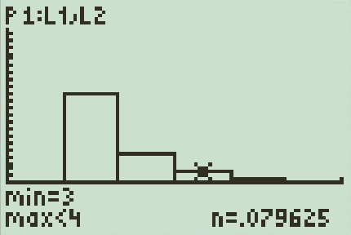
a)
(Note: “Between 1 and 2” is correct and acceptable, but an integer
is not correct)
c)
b)
d)

Slide 26
A person has a 15% chance of winning a daily office game. What is the probability that she first wins on the fifth day?

Slide 27
Homework:
TPS 8.36, 8.41, 8.43, 8.44

